Slide 1
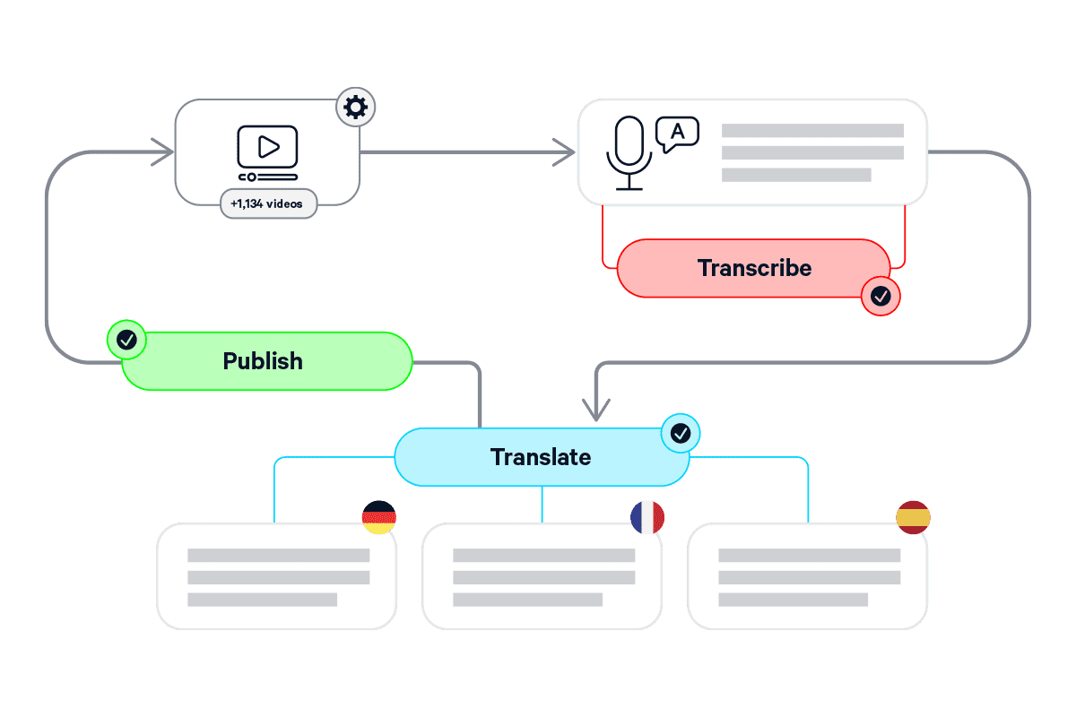
HUGELY POWERFUL, BEAUTIFULLY SIMPLE
Introducing Automation
CaptionHub's no-code subtitling-at-scale capability – gives non-developers the power to set up hugely powerful, API level, automated subtitling workflows – in seconds and without a single line of code

Slide 2
KEY BENEFITS
SCALE WORKFLOWS EFFORTLESSLY
Automate as little or as much as your wish, from simple tagging to entire end-to-end workflows
Automation benefits
ENSURE CONSISTENCY ACROSS CAPTIONS
Establish rules and easily apply them to multiple projects, in multiple languages
From simple tagging through to full automated end-to-end workflows, you're guaranteed to find a use for Automation
IMMEDIATE, DEMONSTRABLE ROI
Greatly reduce - or fully automate - repetitive tasks, removing pain that would typically be solved by time, cost, or both
Automation
ZERO CODING REQUIRED
With a powerful - yet simple - interface, you will be up and running in a matter of minutes

Slide 3
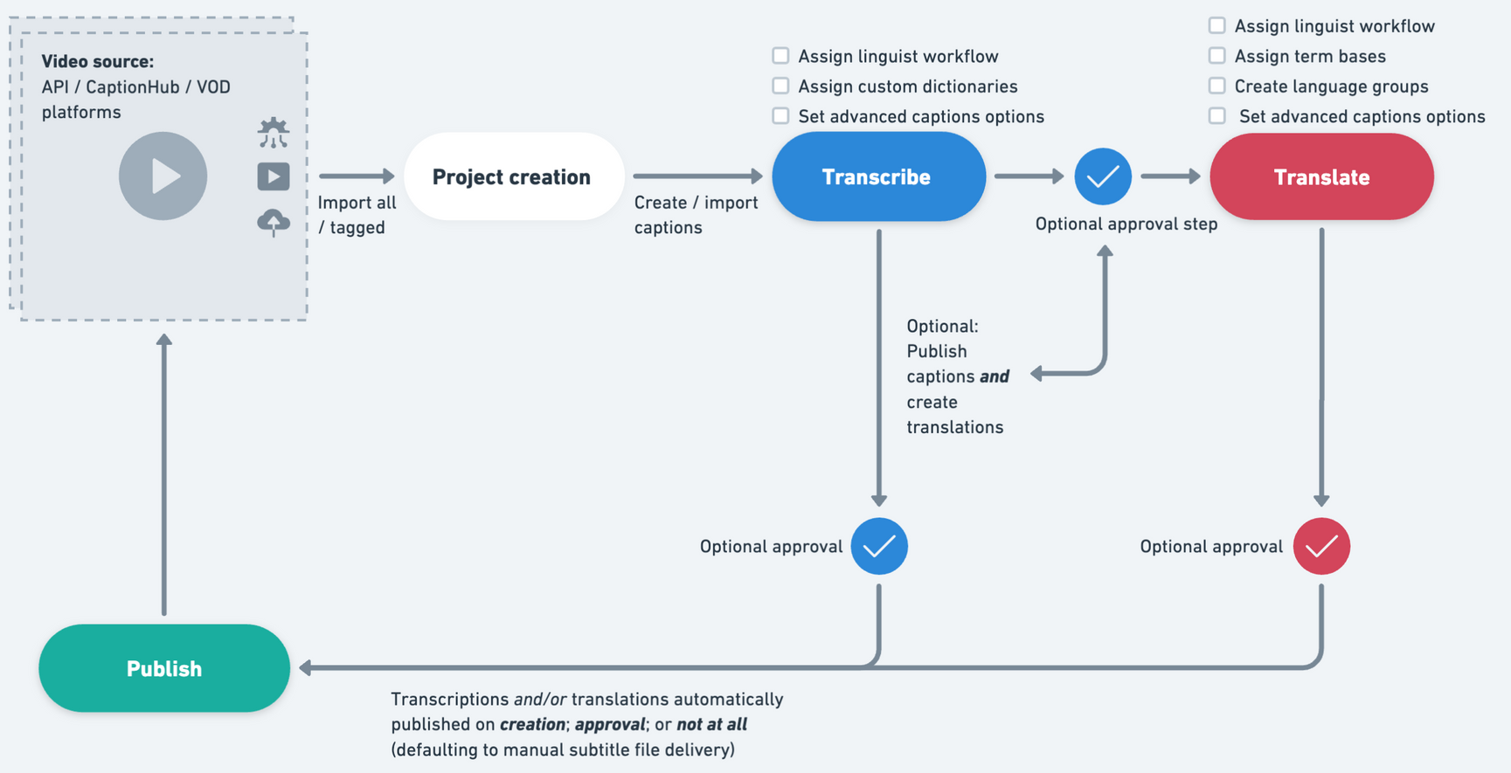
AUTOMATION WORKFLOW OPTIONS
End-to-end support
Start small, or jump right in. With Automation, you are free to decide how little or how much of your workflow you wish to automate including your review & approve workflows

